Slide 1
Calculating any term
Sequences

Slide 2
how to use Oak lessons

Slide 3
I can calculate any term using the n^{th} term.

Slide 4
An arithmetic (or linear) sequence is a sequence where the difference between successive terms is a constant.
The n^{th} term of a sequence is the position of a term in a sequence where n stands for the term number.
For example, if n = 10 this means the 10th term in the sequence.
Because the n^{th} term can be used to calculate any term in a sequence it is also a formula for finding the n^{th} term.

Slide 5

Calculating any term
Generating sequences using n^{th} terms
Using n^{th} terms to find any term
Comparing n^{th} terms of different sequences

Slide 6



Generating sequences using n^{th} terms
Lucas and Alex are discussing the arithmetic sequence with the n^{th} term 3n + 2
I think it starts at 3 and adds 2 each time.
The first five terms will be 3, 5, 7, 9, and 11.
I think it starts at 2 and adds 3 each time.
The first five terms will be 2, 5, 8, 11, and 14.
How do we know who is right?

Slide 7


Generating sequences using n^{th} terms
Substitution is the skill that will help us to find the first five terms of the sequence with the n^{th} term 3n + 2
Term number (n) | 1 | 2 | 3 | 4 | 5
Term |  | 8 | 11 | 14 | 17
5
n = 1
3(1) + 2
= 3 × 1 + 2
= 3 + 2
= 5
n = 2
3(2) + 2
= 3 × 2 + 2
= 6 + 2
= 8
n = 3
3(3) + 2
= 3 × 3 + 2
= 9 + 2
= 11
n = 4
3(4) + 2
= 3 × 4 + 2
= 12 + 2
= 14
n = 5
3(5) + 2
= 3 × 5 + 2
= 15 + 2
= 17

Slide 8

Generating sequences using n^{th} terms
Find the first five terms of the sequence
Term number (n) | 1 | 2 | 3 | 4 | 5
Term | 6 | 11 | 16 | 21 | 26
n = 1
5(1) + 1
= 5 × 1 + 1
= 5 + 1
= 6
n = 2
5(2) + 1
= 5 × 2 + 1
= 10 + 1
= 11
n = 3
5(3) + 1
= 5 × 3 + 1
= 15 + 1
= 16
n = 4
5(4) + 1
= 5 × 4 + 1
= 20 + 1
= 21
n = 5
5(5) + 1
= 5 × 5 + 1
= 25 + 1
= 26

Slide 9

Generating sequences using n^{th} terms
Find the first five terms of the sequence
Term number (n) | 1 | 2 | 3 | 4 | 5
Term | 110 | 120 | 130 | 140 | 150
The first five terms are 110, 120, 130, 140 and 150.
n = 1
100 + 10(1)
= 100 + 10 × 1
= 100 + 10
= 110
n = 2
100 + 10(2)
= 100 + 10 × 2
= 100 + 20
= 120
n = 3
100 + 10(3)
= 100 + 10 × 3
= 100 + 30
= 130
n = 4
100 + 10(4)
= 100 + 10 × 4
= 100 + 40
= 140
n = 5
100 + 10(5)
= 100 + 10 × 5
= 100 + 50
= 150

Slide 10



Generating sequences using n^{th} terms
Find the first five terms of the sequence
Before we begin, how do you think this sequence will differ to ?
I think it’s the same as 100+10n but in the negatives.
−110, −120, −130, −140, −150, …
I think it starts at 100 and goes down 10 each time.
The first five terms will be 100, 90, 80, 70 and 60.
Aisha
Sofia

Slide 11
Generating sequences using n^{th} terms
Find the first five terms of the sequence
Term number (n) | 1 | 2 | 3 | 4 | 5
Term | 90 | 80 | 70 | 60 | 50
The first five terms are 90, 80, 70, 60 and 50.
n = 1
100 − 10(1)
= 100 − 10 × 1
= 100 − 10
= 90
n = 2
100 − 10(2)
= 100 − 10 × 2
= 100 − 20
= 80
n = 3
100 − 10(3)
= 100 − 10 × 3
= 100 − 30
= 70
n = 4
100 - 10(4)
= 100 - 10 × 4
= 100 - 40
= 60
n = 5
100 - 10(5)
= 100 - 10 × 5
= 100 - 50
= 50

Slide 12


Generating sequences using n^{th} terms
Laura writes the first five terms of the arithmetic sequence in this table.
Term number (n) | 1 | 2 | 3 | 4 | 5
Term | 8 | 6.9 | 5.8 | 4.7 | 3.6
I don’t need to do any working out. It’s arithmetic so I can just start at 8 and subtract 1.1 each time.
Explain to Laura what she has done wrong, and what she could do better.

Slide 13
Generating sequences using n^{th} terms
Laura writes the first five terms of the arithmetic sequence in this table.
Term number (n) | 1 | 2 | 3 | 4 | 5
Term | 8 | 6.9 | 5.8 | 4.7 | 3.6
Your explanation might have included:
The sequence does go in steps of -1.1 but the first term is not 8.
Use substitution to accurately find terms. When n = 1,
8 - 1.1n = 8 - 1.1 × 1 = 8 - 1.1 = 6.9, that’s your first term.

Slide 14


Generating sequences using n^{th} terms
1) Use substitution to find the first five terms of these arithmetic sequences.
a)
Term number (n) | 1 | 2 | 3 | 4 | 5
Term
b)
Term number (n) | 1 | 2 | 3 | 4 | 5
Term

Slide 15


Generating sequences using n^{th} terms
1) Use substitution to find the first five terms of these arithmetic sequences.
c)
Term number (n) | 1 | 2 | 3 | 4 | 5
Term
d)
Term number (n) | 1 | 2 | 3 | 4 | 5
Term

Slide 16


Generating sequences using n^{th} terms
2) Jun says:
The sequence must go up in threes because it says, “+3”
Use substitution to find the first five terms and show Jun that he is mistaken.
Term number (n) | 1 | 2 | 3 | 4 | 5
Term

Slide 17
Generating sequences using n^{th} terms
1) Use substitution to find the first five terms of these arithmetic sequences.
a)
Term number (n) | 1 | 2 | 3 | 4 | 5
Term | 8 | 13 | 18 | 23 | 28
n = 1
5(1) + 3
= 5 + 3
= 8
n = 2
5(2) + 3
= 10 + 3
= 13
n = 3
5(3) + 3
= 15 + 3
= 18
n = 4
5(4) + 3
= 20 + 3
= 23
n = 5
5(5) + 3
= 25 + 3
= 28

Slide 18
Generating sequences using n^{th} terms
1) Use substitution to find the first five terms of these arithmetic sequences.
b)
Term number (n) | 1 | 2 | 3 | 4 | 5
Term | 0.35 | 0.4 | 0.45 | 0.5 | 0.55
n = 1
0.05(1) + 0.3
= 0.05 + 0.3
= 0.35
n = 1
0.05(2) + 0.3
= 0.1 + 0.3
= 0.4
n = 1
0.05(3) + 0.3
= 0.15 + 0.3
= 0.45
n = 1
0.05(4) + 0.3
= 0.2 + 0.3
= 0.5
n = 1
0.05(5) + 0.3
= 0.25 + 0.3
= 0.55

Slide 19
Generating sequences using n^{th} terms
1) Use substitution to find the first five terms of these arithmetic sequences.
c)
Term number (n) | 1 | 2 | 3 | 4 | 5
Term | 2.3 | 1.6 | 0.9 | 0.2 | -0.5
n = 1
3 - 0.7(1)
= 3 - 0.7
= 2.3
n = 2
3 - 0.7(2)
= 3 - 1.4
= 1.6
n = 3
3 - 0.7(3)
= 3 - 2.1
= 0.9
n = 4
3 - 0.7(4)
= 3 - 2.8
= 0.2
n = 5
3 - 0.7(5)
= 3 - 3.5
= -0.5

Slide 20
Generating sequences using n^{th} terms
1) Use substitution to find the first five terms of these arithmetic sequences.
d)
Term number (n) | 1 | 2 | 3 | 4 | 5
Term | -3.7 | -4.4 | -5.1 | -5.8 | -6.5
n = 1
-3 - 0.7(1)
= -3 - 0.7
= -3.7
n = 2
-3 - 0.7(2)
= -3 - 1.4
= -4.4
n = 3
-3 - 0.7(3)
= -3 - 2.1
= -5.1
n = 4
-3 - 0.7(4)
= -3 - 2.8
= -5.8
n = 5
-3 - 0.7(5)
= -3 - 3.5
= -6.5

Slide 21
Generating sequences using n^{th} terms
2) Jun says:
The sequence must go up in threes because it says, “+3”
n = 1
(1) + 3 = 4
n = 2
(2) + 3 = 5
n = 3
(3) + 3 = 6
n = 4
(4) + 3 = 7
n = 5
(5) + 3 = 8
Term number (n) | 1 | 2 | 3 | 4 | 5
Term
Term number (n) | 1 | 2 | 3 | 4 | 5
Term | 4 | 5 | 6 | 7 | 8
The sequence begins at 4 and goes up 1 each time.

Slide 22

Calculating any term
Generating sequences using terms
Using terms to find any term
Comparing terms of different sequences

Slide 23


Using n^{th} terms to find any term
The first five terms of the arithmetic sequence are below. What is the 100th term?
I’ve got this!
Term number (n) | 1 | 2 | 3 | 4 | 5
Term | 9 | 13 | 17 | 21 | 25
Andeep
29, 33, 37, 41, 45, 49, 53, 57, 61, 65, 69, 73, 77, 81
9, 13, 17, 21, 25,
85, 89, 93, 97, 101, 105, 109, 113, 117, 121, 125, 129, 133, 137, 141
145, 149, 153, 157, 161, 165, 169, 173, …
Am I near yet?
What do you think about Andeep’s method?
Andeep
It’s not very efficient and it might lack accuracy.

Slide 24
Using n^{th} terms to find any term
The first five terms of the arithmetic sequence are below. What is the 100th term?
Term number (n) | 1 | 2 | 3 | 4 | 5 | 100
Term | 9 | 13 | 17 | 21 | 25 | 405
The table is not limited to the first five terms. In fact, we can use it to find any term.
n = 100
4(100) + 5
= 400 + 5
= 405

Slide 25

Using n^{th} terms to find any term
Use substitution to find the 50th, 100th, and 1000th terms of the sequence
Term number (n) | 50 | 100 | 1000
Term | 525 | 1125 | 11 925
n = 50
12(50) - 75
= 600 - 75
= 525
n = 100
12(100) - 75
= 1200 - 75
= 1125
n = 1000
12(1000) - 75
= 12000 - 75
= 11 925

Slide 26
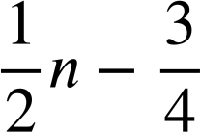
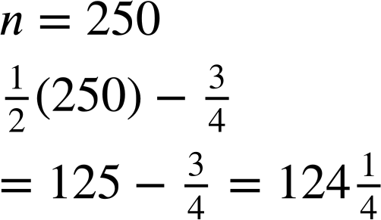
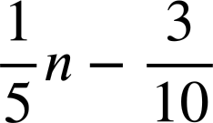
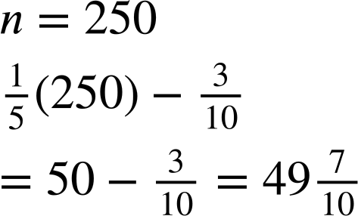

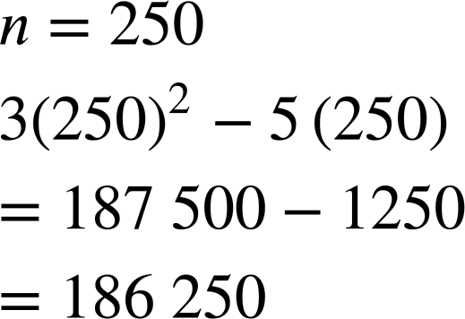

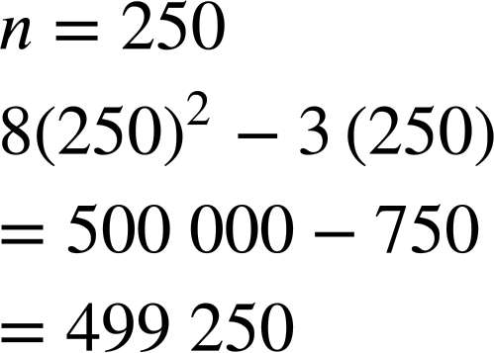
Using n^{th} terms to find any term
Find the 250th term of the below sequences:
Find the 250th term of the below sequences:

Slide 27
Using n^{th} terms to find any term
The first five terms of the sequence are...
Term number (n) | 1 | 2 | 3 | 4 | 5
Term | 6 | 11 | 16 | 21 | 26
Do you agree with Alex?
The 5th term is 26 so the 10th term will be 52 because that’s double.
Let’s check.
n = 10
5(10) + 1
= 50 + 1 = 51
Alex
51 ≠ 2 × 26

Slide 28
Using n^{th} terms to find any term
The sequence
Why is he wrong?
Term number (n) | 5 | 10
Term | 26 | 51
n = 10
5(10) + 1
= 50 + 1 = 51
The 5th term is 26 so the 10th term will be 52 because that’s double.
n = 5
5(5) + 1
= 25 + 1 = 26
The number of 5s doubled
Alex
but, the +1 did not.

Slide 29


Using n^{th} terms to find any term
The 5th term of is 45 so the 10th term must be 90.
10 is double 5, 90 is double 45
When n = 10 the term is 8(10) + 5 = 85 ≠ 90

Slide 30


Using n^{th} terms to find any term
1) The first five terms of the arithmetic sequence are 37, 32, 27, 22, and 17.
Jacob wants to find the 20th term.
37, 32, 27, 22, 17, 12, 7, 2, -2, -7, -12, -17, -22, -27, -32, -37, -42, -47, -52, -57. There it is. The 20th term is -57
Spot Jacob’s error and explain a better method to him.

Slide 31





Using n^{th} terms to find any term
2) Find the 20th, 100th, and 200th terms of the below sequences.
a)
b)
c)
d)
e)

Slide 32
Using n^{th} terms to find any term
1) The first five terms of the arithmetic sequence are 37, 32, 27, 22, and 17.
Jacob wants to find the 20th term.
His error was 2 − 5 = -3
37, 32, 27, 22, 17, 12, 7, 2, −2, −7, −12, −17, −22, −27, −32, −37, −42, −47, −52, −57. There it is. The 20th term is -57
You might have said,
“Your method was inefficient. If you know the n^{th} term use substitution.”
Spot Jacob’s error and explain a better method to him.
42 − 5(20) = 42 − 100 = −58

Slide 33
Using n^{th} terms to find any term
2) Find the 20th, 100th and 1000th terms of the below sequences.
a)
n = 20
7(20) − 6
= 140 − 6 = 134
n = 100
7(100) − 6
= 700 − 6 = 694
n = 1000
7(1000) − 6
= 7000 − 6 = 6994
b)
n = 20
6 − 7(20)
= 6 − 140 = −134
n = 100
6 − 7(100)
= 6 − 700 = −694
n = 1000
6 − 7(1000)
= 6 − 7000 = −6994
c)
n = 20
0.06 − 0.7(20)
= −13.94
n = 100
0.06 − 0.7(100)
= −69.94
n = 1000
0.06 − 0.7(1000)
= −699.94

Slide 34
Using n^{th} terms to find any term
2) Find the 20th, 100th and 1000th terms of the below sequences.
d)
n = 20
(20)² + 3(20)
= 400 + 60 = 460
n = 100
(100)² + 3(100)
= 10 000 + 300 = 10 300
n = 1000
(1000)² + 3(1000)
= 1 003 000
e)
n = 20
3(20) + 15 − 4(20)²
= -1525
n = 100
3(100) + 15 - 4(100)²
= -39 685
n = 1000
3(1000) + 15 − 4(1000)²
= -3 996 985

Slide 35
Calculating any term
Generating sequences using terms
Using terms to find any term
Comparing terms of different sequences

Slide 36

Comparing n^{th} terms of different sequences
We can now compare sequences.
n | 1 | 2 | 3 | 4 | 5
T | 3 | 4 | 5 | 6 | 7
n | 1 | 2 | 3 | 4 | 5
T | 4 | 5 | 6 | 7 | 8
Find the first five terms of each sequence.
Compare the sequences.
Both sequences are arithmetic. They both have a common difference of 1.
n+2 starts at 3, whereas n+3 starts 1 higher at 4.
In fact, n+3 is always 1 higher than n+2 for all values of n.

Slide 37


Comparing n^{th} terms of different sequences
Find the first five terms and compare these sequences.
n | 1 | 2 | 3 | 4 | 5
T | 7 | 12 | 17 | 22 | 27
n | 1 | 2 | 3 | 4 | 5
T | 3 | 8 | 13 | 18 | 23
You might have said:
Both sequences are arithmetic. They both have a common difference of +5.
They start at different numbers. 5n + 2 starts at 5+2 whereas 5n - 2 starts at 5-2
5n + 2 is always 2 above our 5 times tables, whereas 5n - 2 is always 2 below it.

Slide 38




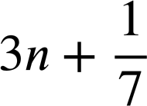


Comparing n^{th} terms of different sequences
Find the first five terms of each of these sequences and compare them:
a)
b)
c)
d)
e)
f)
g)
h)

Slide 39



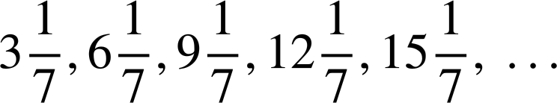

Comparing n^{th} terms of different sequences
Find the first five terms of each of these sequences and compare them:
a)
b)
c)
d)
e)
f)
g)
Sequences a) to g) were all arithmetic. They all had a constant common difference.

Slide 40
Comparing n^{th} terms of different sequences
Find the first five terms of each of these sequences and compare them:
a)
b)
c)
d)
e)
f)
g)
a) to e) all had a common difference of +3. They were increasing sequences.
f) and g) had a common difference of -3, decreasing.

Slide 41
Comparing n^{th} terms of different sequences
Find the first five terms of each of these sequences and compare them:
a)
b)
c)
d)
e)
The 3 times tables
Two more than the 3 times tables
One less than the 3 times tables
0.7 more than the 3 times tables
One seventh more than the 3 times tables

Slide 42

Comparing n^{th} terms of different sequences
Find the first five terms of each of these sequences and compare them:
Starting points:
a)
b)
c)
d)
e)
f)
g)
3 + 0
3 + 2
3 - 1
3 + 0.7
3 +
-3 + 7
2 - 3

Slide 43

Comparing n^{th} terms of different sequences
Find the first five terms of each of these sequences and compare them:
a)
b)
c)
d)
e)
f)
g)
h)
Not arithmetic

Slide 44
Calculating any term
We can use substitution to find any term in a sequence when given the n^{th} term.
For example, the 50th term of the sequence 12n² – 71 is found by substituting n = 50
12(50)² - 71 = 29 929

Slide 45

© Oak National Academy 2023.
Produced in partnership with Mathematics in Education and Industry.
Licensed on the Open Government Licence v3.0, except where otherwise stated. See Oak terms and conditions.

